Slide 1


Wound Healing

Slide 2
Definition include the repair or reconstitution of a defect in an organ or tissue, commonly the skin.
1-scar formation
2-Regeneration
neural injury and skin is characterized by little regeneration and much scarring, hepatic and bone injury usually heals primarily through regeneration.

Slide 3
Remodeling phase
Inflammatory phase
Proliferactive phase

Slide 4
Remodeling phase
Proliferactive phase
Inflammatory phase

Slide 5
Remodeling phase
Inflammatory phase
Proliferactive phase

Slide 6
Remodeling phase
Inflammatory phase
Proliferactive phase

Slide 7
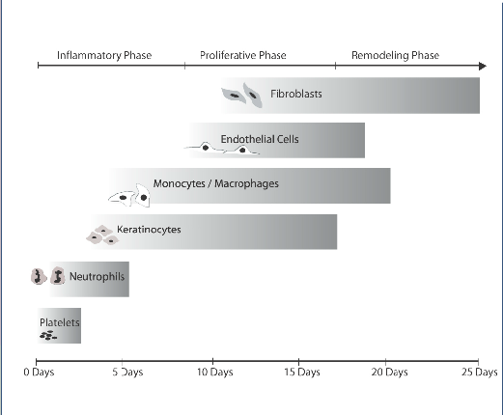

Slide 8
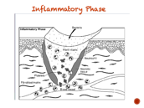
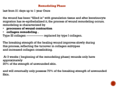
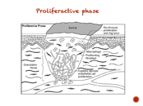
Remodeling phase
Prolifeactive phase
Inflammatory phase

Slide 9
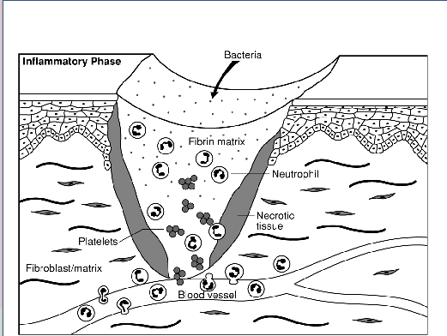
Inflammatory Phase

Slide 10
Inflammatory Phase
Hemostasis
removal of dead and devitalized tissues
and prevention of colonization and invasive infection by microbial pathogens
fibrin -- polymerization into a gel--- fibrin matrix (scaffolding for cell migration )
Neutrophilic infiltrate first 2 days
remove dead tissue by phagocytosis and to prevent infection
absence does not prevent the overall progress of wound healing
Monocyte/macrophages
appear 48 to 72 hours after injury.
macrophages originate from the circulation,
By the third day they are predominant cell type in the healing wound.
phagocytoses debris and bacteria,
controled production of the growth factors necessary for production of the extracellular matrix by fibroblasts and the production of new blood vessels in the healing wound.

Slide 11
However, it is clear that unlike the neutrophil the absence of monocyte/macrophages has severe consequences for healing wounds
Lymphocyte is the last cell to enter the wound and enters
between 5 and 7 days after wounding
mast cell appears during the later part of the inflammatory phase, its function remains unclear.
aberrant scarring

Slide 12
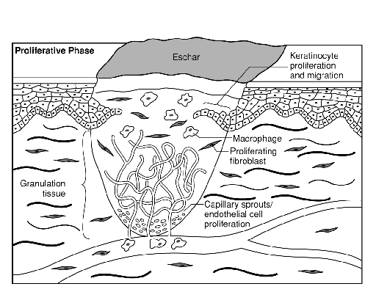
Proliferactive phase

Slide 13
Proliferative Phase days 4 to 21
Keratinocytes adjacent to the wound alter their phenotype in the hours following injury. Regression of the desmosomal connections between keratinocytes and to the underlying basement membrane frees the cells and allows them to migrate laterally between the desiccated eschar and the provisional fibrin matrix beneath
provisional fibrin matrix ------------ granulation tissue.
Granulation tissue is composed of three cell types that
Fibroblasts,
Macrophages,
Endothelial cells.
Granulation tissue begins to appear in human wounds by about day 4 post injury
Over time the provisional matrix of fibrin is replaced with type III collagen by fibroblast
Endothelial cells form new blood vessels through angiogenesis and vasculogenesis .
One interesting element of the proliferative phase of wound healing is that at a certain point all of these processes need to be turned off and the formation of granulation tissue/extracellular matrix halted
once collagen matrix has filled in the wound cavity, fibroblasts rapidly disappear and newly formed blood regress
Because dysregulation of this process is believed to produce hypertrophic scarring

Slide 14
Remodeling Phase
last from 21 days up to 1 year Once
the wound has been “filled in” with granulation tissue and after keratinocyte migration has re-epithelialized it, the process of wound remodeling occurs.
remodeling is characterized by
processes of wound contraction
collagen remodeling .
Type III collagen ---------------- replaced by type I collagen.
The breaking strength of the healing wound improves slowly during
this process, reflecting the turnover in collagen subtypes
and increased collagen crosslinking.
At 3 weeks ( beginning of the remodeling phase) wounds only have approximately
20% of the strength of unwounded skin.
and will eventually only possess 70% of the breaking strength of unwounded
Skin.

Slide 15
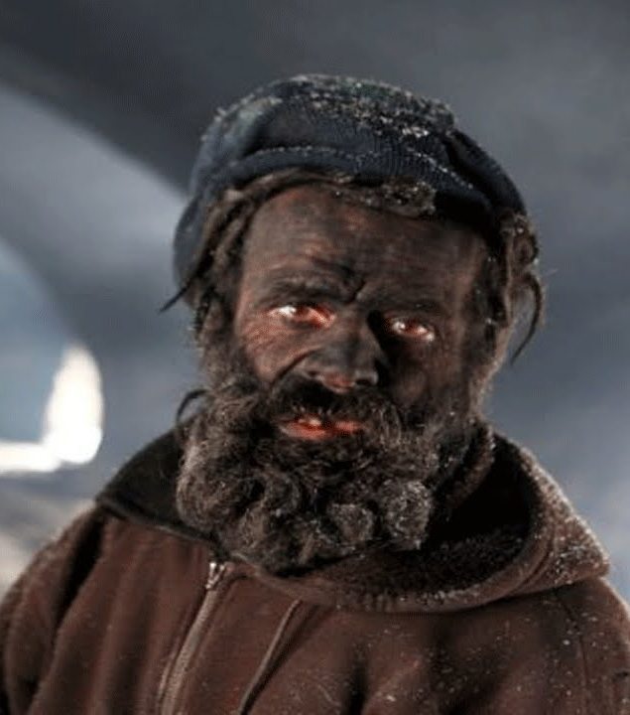
Q 2016 T or F :- As re-epithelialization progress rapidly in wound healing the patient can take a shower after 21 days after surgery.
Answer : as the wound healing process take 1-2 years the patient should not shower for that period.
دكتور بلا زحمة يمتة اسبح

Slide 16
Factors Affecting wound healing
Age
Ischemia
Infection
Foreign body
Malnutrition
global
Nutrient – specific
Diabetes
Steroid
Uremia
Jaundice
Cancer
Irradiation
Chemotherapy
Genetic causes ( Ehler-Denlos)
Tobacco
Alcohol
Edema
Pressure

Slide 17
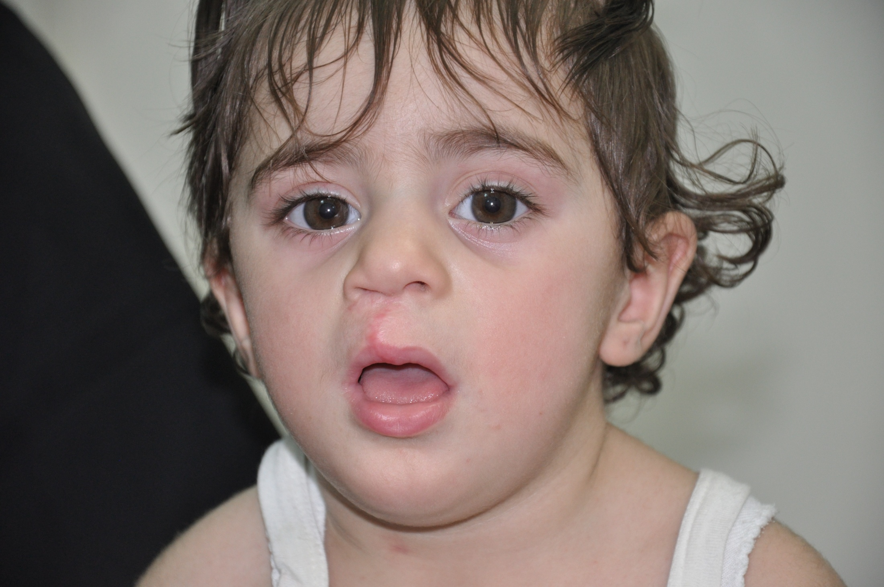

Slide 18
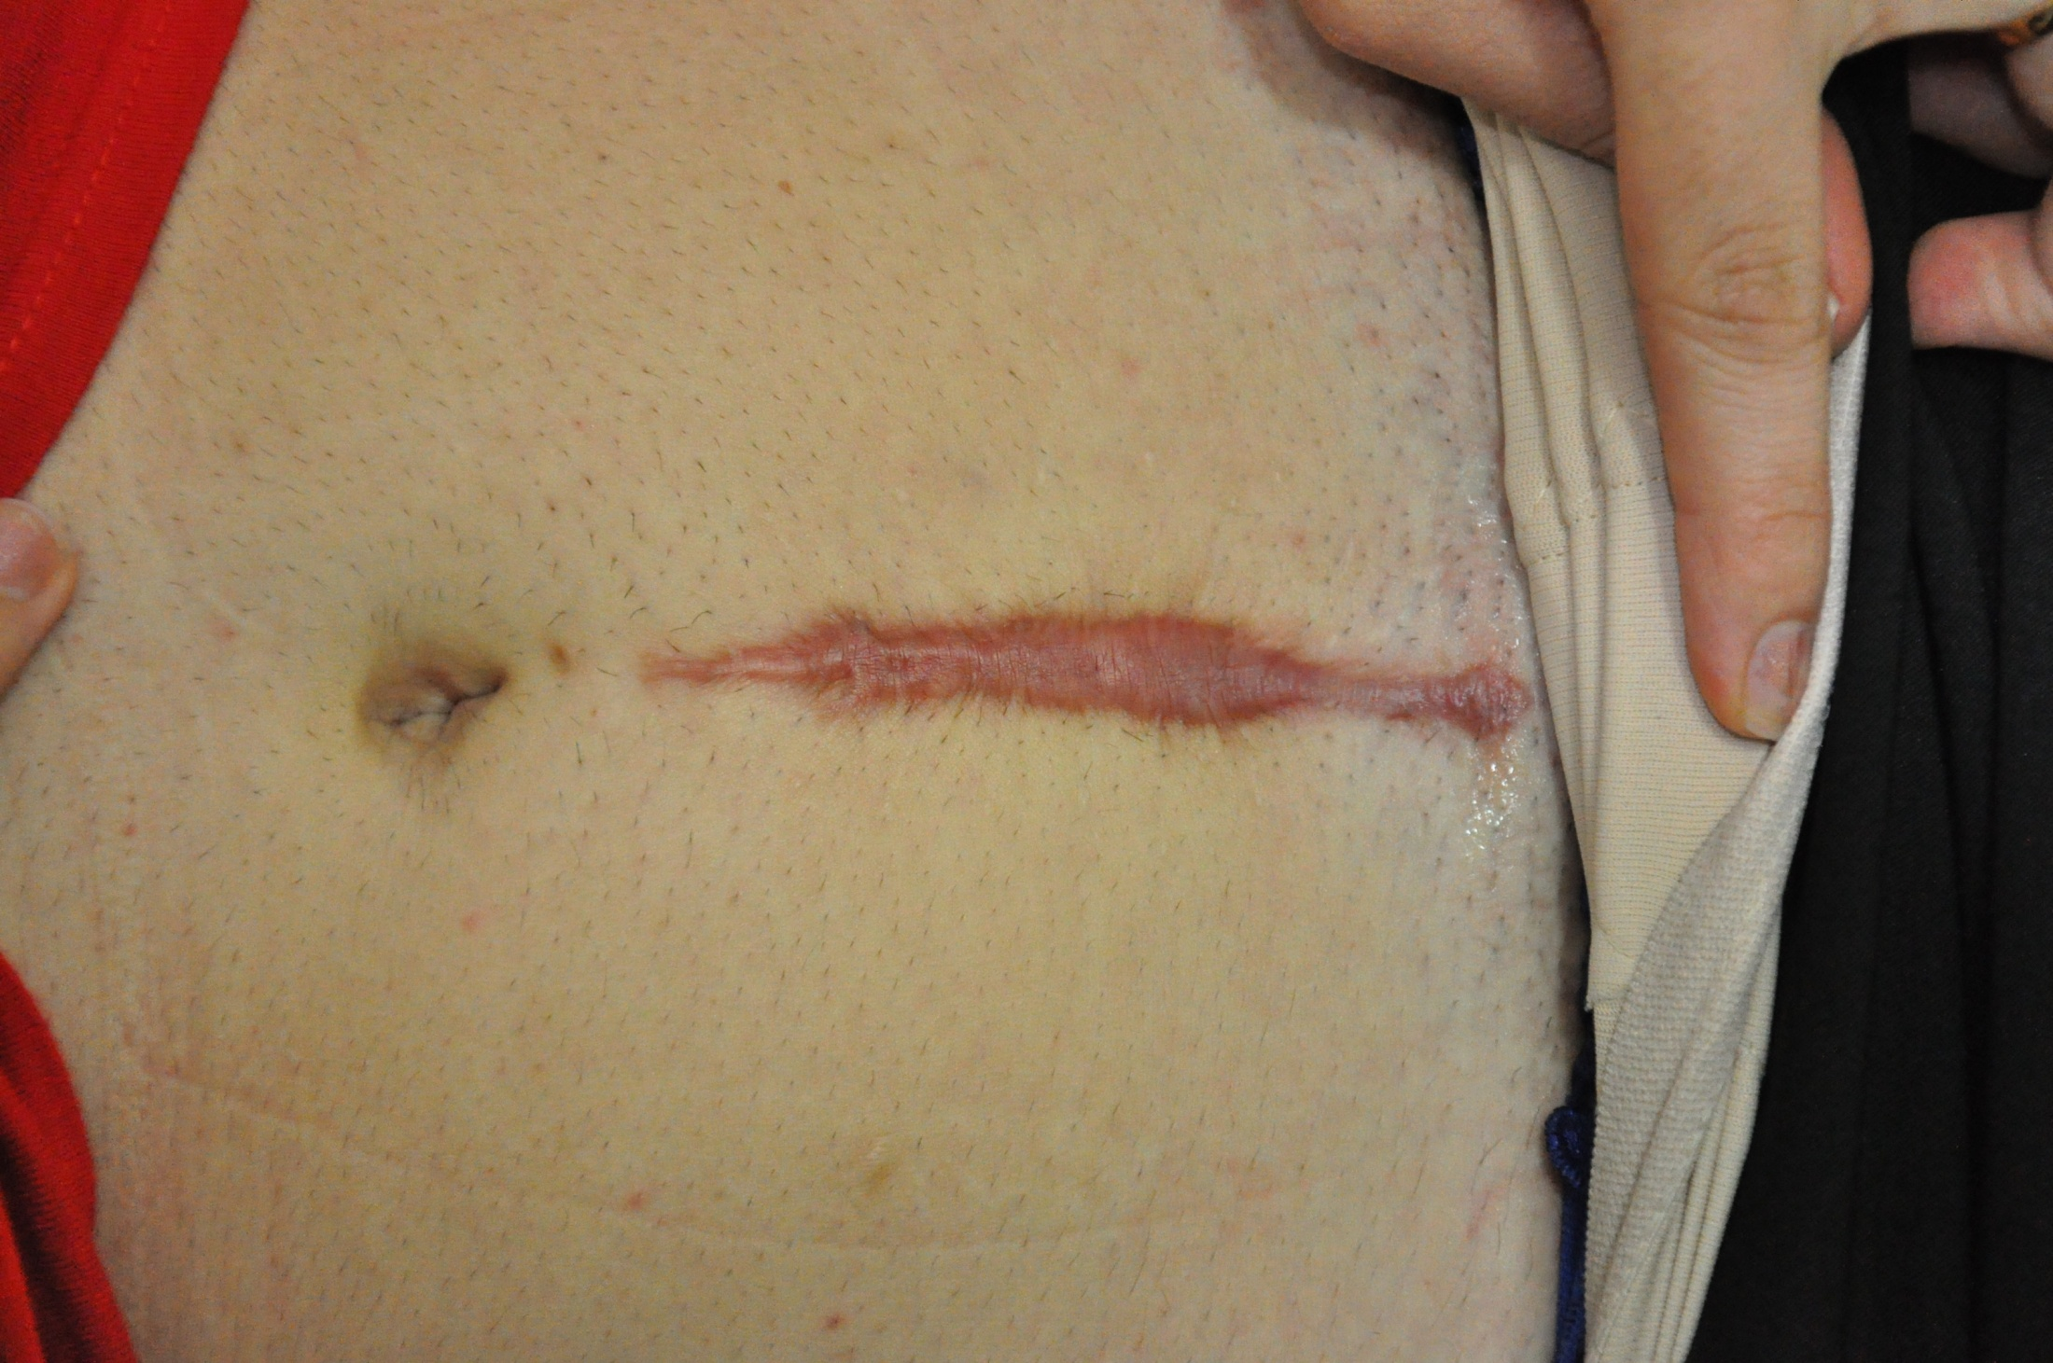

Slide 19
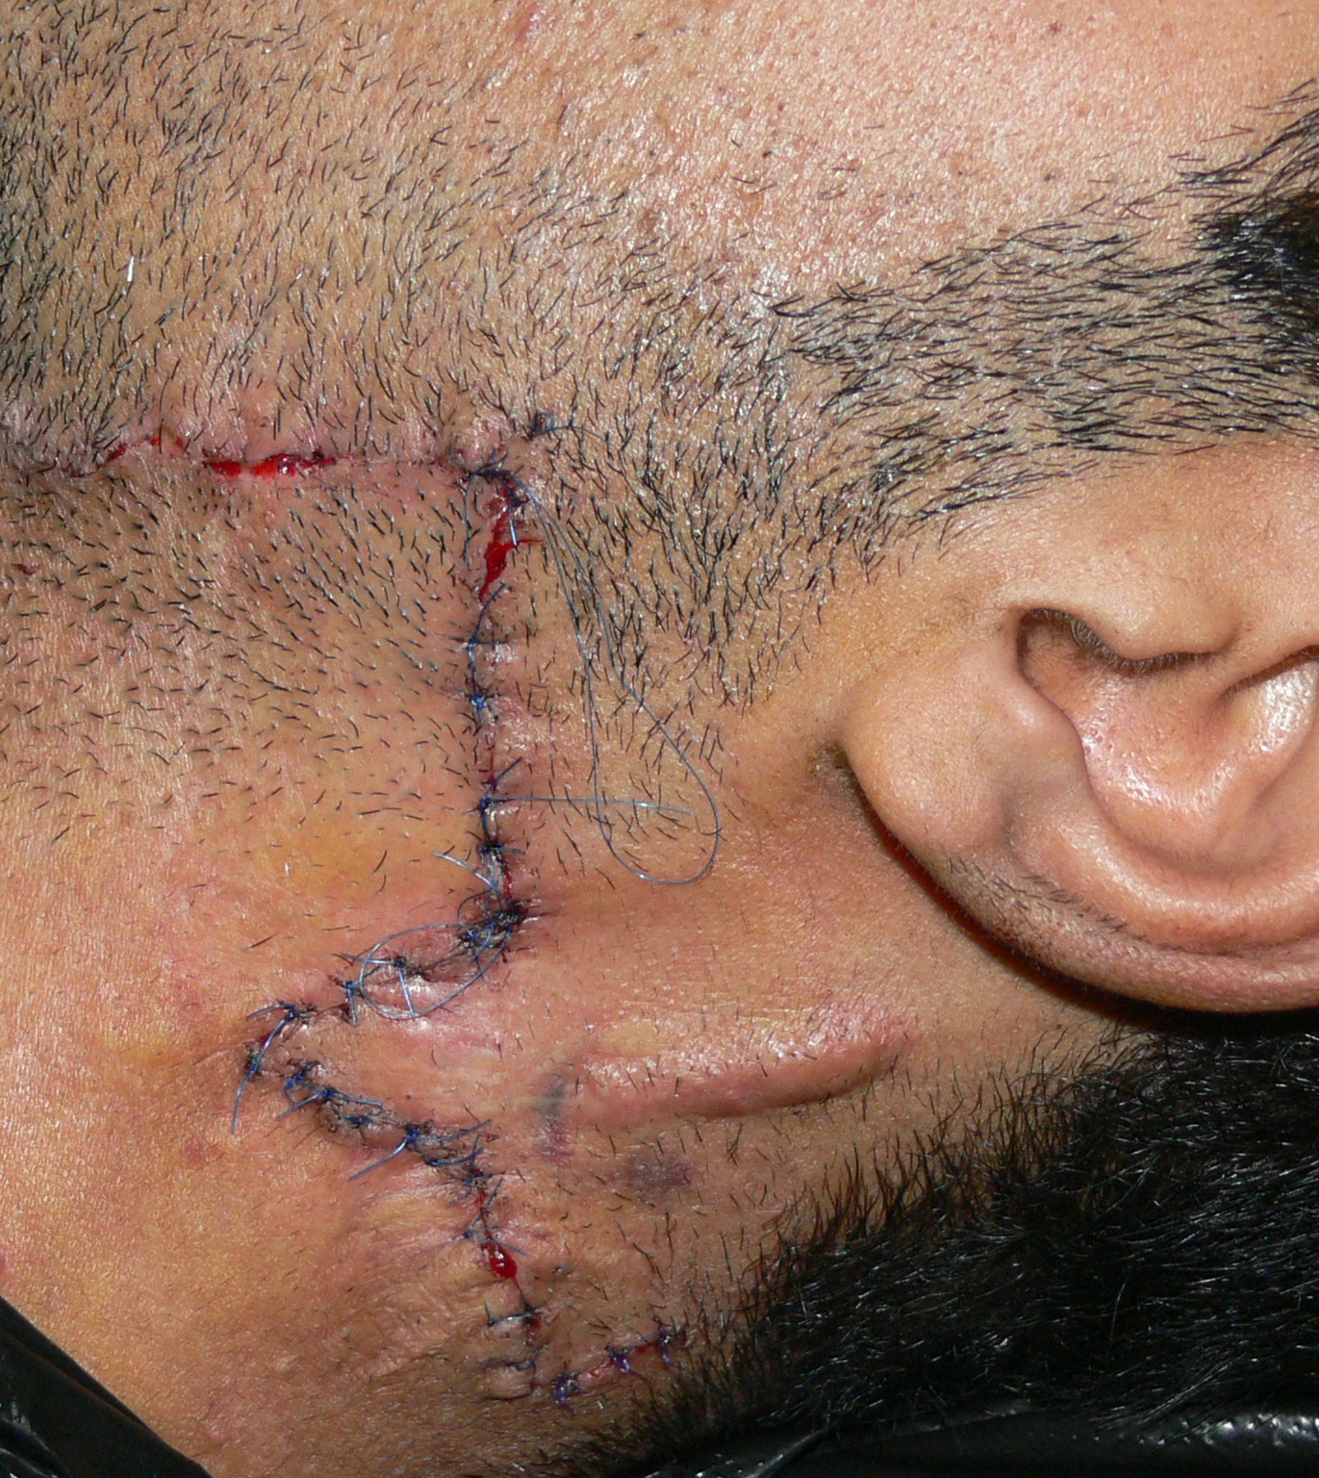
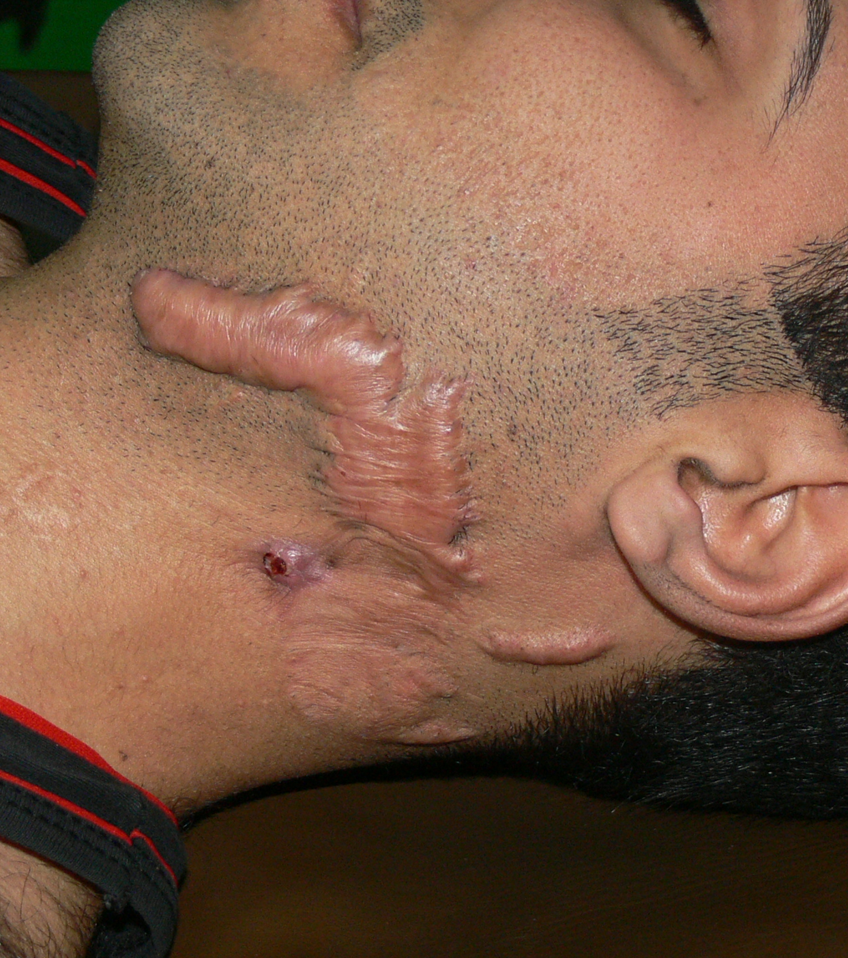

Slide 20
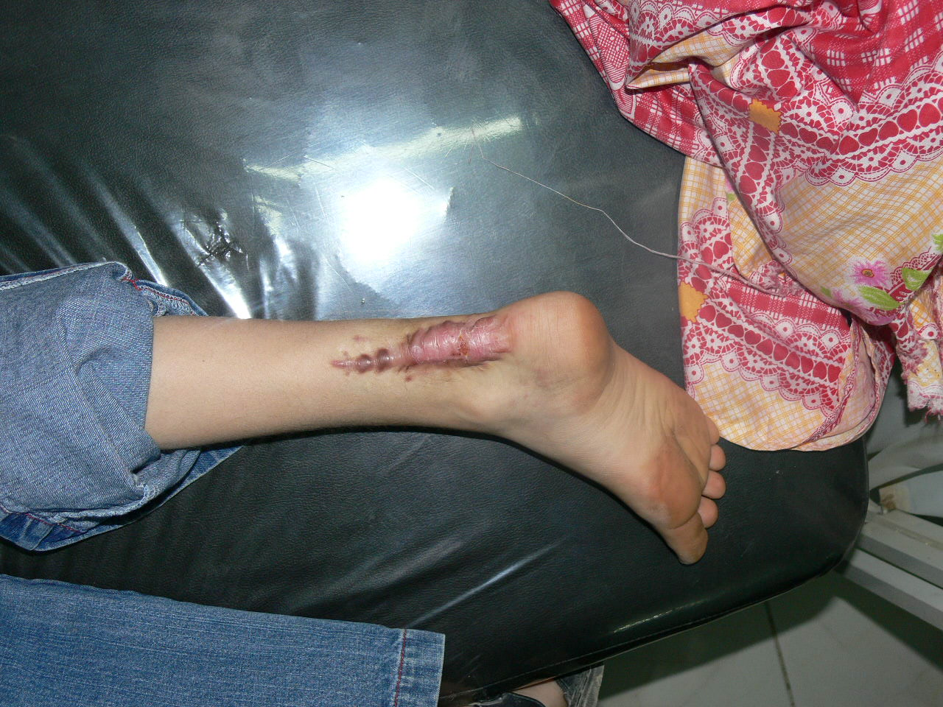

Slide 21
Hypertrophic | keloid
Before 6 months | After 6 months
Limited to the wound edge | Extend beyond the wound
Resolve spontaneously | Permanent
Every body can have | some times hereditary
Wound contracture | less wound contracture

Slide 22
Thank you

